Slide 1

UNIVERSITY INSTITUTE OF TECHNOLOGY,RGPV
MAJOR PROJECT
BUGS TRACKING APP
Session : 2021 – 2022
Under the guidance of : Submitted by :
Dheeresh Chandra Kushwaah Dinesh Awatramani
Department : M.C.A Enrollment No. : 0101CA191004
Language : Java Semester : VI sem.

Slide 2
Introduction
Online Library Management System is a system which maintains the information about the books present in the library, their authors, the members of library to whom books are issued. This is very difficult to organize manually. Maintenance of all this information manually is a very complex task.
Owing to the advancement of technology, organization of an Online Library becomes much simple. The Online Library Management has been designed to computerize and automate the operations performed over the information about the members, book issues and returns and all other operations. This computerization of library helps in many instances of its maintenances. It reduces the workload of management as most of the manual work done is reduced

Slide 3
Objective
The project aims and objectives that will be achieved after completion of this project are discussed in this subchapter. The aims and objectives are as follow
Facility to download required book.
Video tutorial for students.
An Admin login page where admin can add books ,delete, update

Slide 4
TECHNOLOGIES
UI : React J.S, Html, Css.
Backend : Spring Boot, Java
Database : PostgreSql.

Slide 5
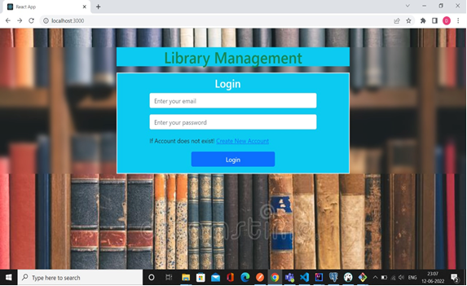
Login

Slide 6
Hardware Requirement
PROCESSOR | INTEL CORE PROCESSOR OR BETTER PERFORMANCE
OPERATING SYSTEM | WINDOWS VISTA ,WINDOWS7, UBUNTU
MEMORY | 1GB RAM OR MORE
HARD DISK SPACE | MINIMUM 3 GB FOR DATABASE USAGE FOR FUTURE
DATABASE | POSTGRESQL

Slide 7
Software Requirements
Operating system- Windows 7 is used as the operating system as it is stable and supports more features and is more user friendly
Database POSTGRESQL is used as database as it easy to maintain and retrieve records by simple queries which are in English language which are easy to understand and easy to write.
Development tools and Programming language- HTML is used to write the whole code and develop WebPages with CSS, Java Script for styling work and Spring Boot for sever side scripting

Slide 8
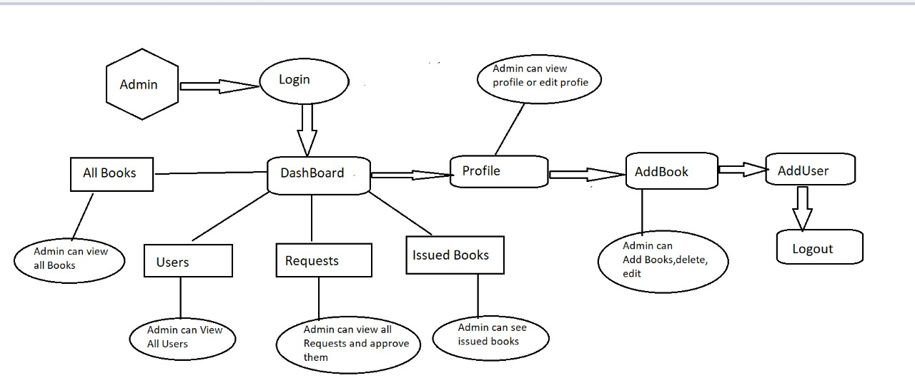
Data Flow Diagramm.
Process.

Slide 9
PERFORMANCE
To solve the inconveniences as mentioned in the existing system, an Online Library is proposed. The proposed system contains the following features:
The students will register them through Online
Individually each member will have his account through which he can access the information he needs.
Book details like authors, number of copies totally maintained by library, present available number of books, reference books, non-reference books etc. all this information can be made handy.
Regarding the members designation, number of books was issued.
Issue dates and returns of each member is maintained separately and fine charged if there is any delay in returning the book.
Administrator can add, update the books.
Time consuming is low, gives accurate results, reliability can be improved with the help of security.

Slide 10
FUTURE REQUIREMENT
As the technology emerges, it is possible to upgrade the system and can be adaptable to desired environment.
Because it is based on object-oriented design, any further changes can be easily adaptable.
Based on the future security issues, security can be improved using emerging technologies.
Attendance module can be added
sub admin module can be added

Slide 11
Future Benefits
Improved productivity.
Optimum utilization of resources.
Efficient management of records.
Simplification of the operations.
Less processing time and getting required information.
User friendly.
Portable and flexible for further enhancement.

Slide 12
Snapshot of Login

Slide 13
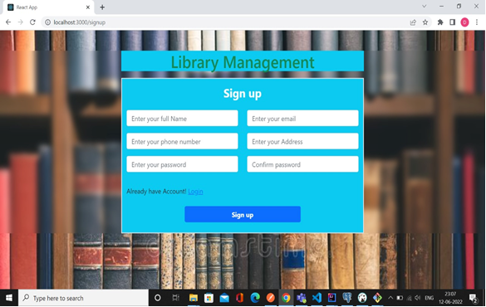
Snapshots of SignUp Page

Slide 14
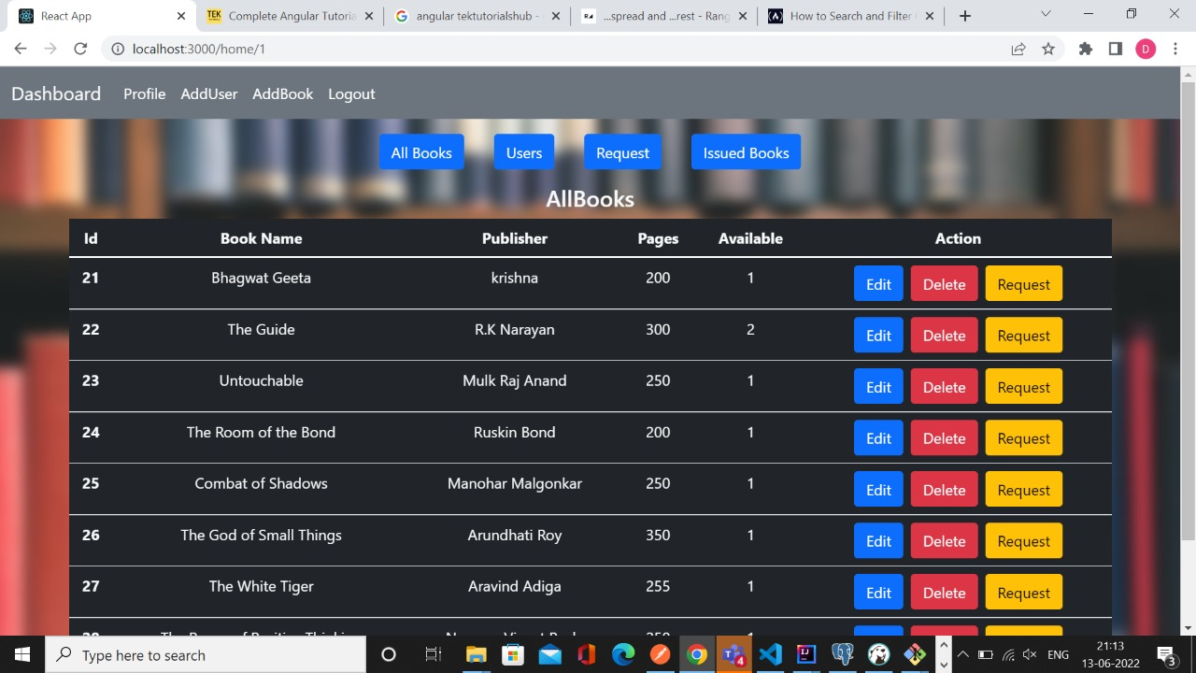
Snapshots of Dashboard

Slide 15
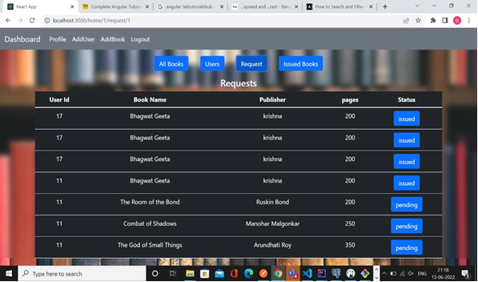
Request Page

Slide 16
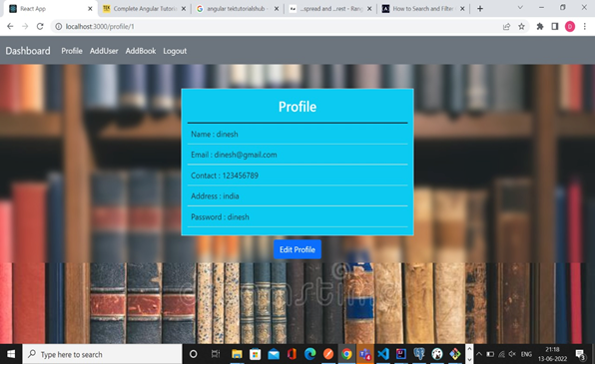
Snapshots of Profile

Slide 17
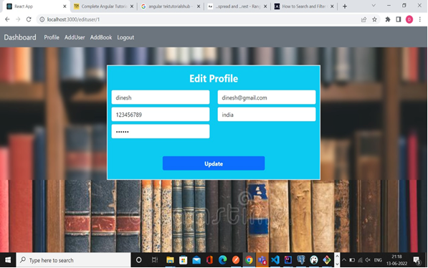
Snapshots of Detail

Slide 18
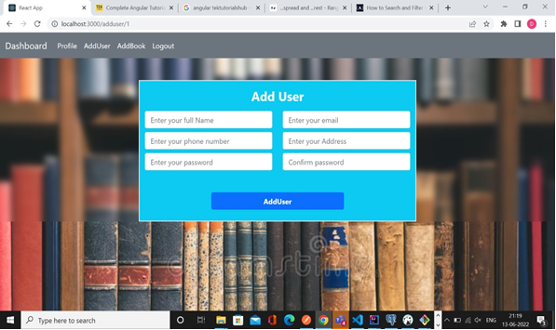
Add User

Slide 19
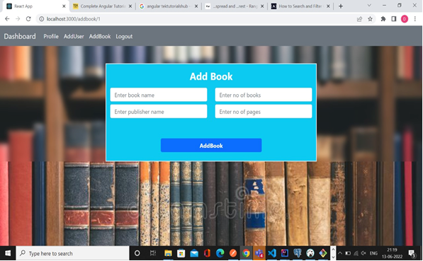
Add Books

Slide 20
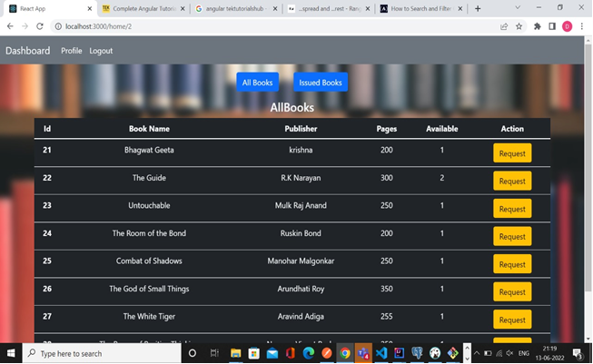
User Dashboard

Slide 21
Conclusions
This website provides a computerized version of library management system which will benefit the students as well as the staff of the library.
It makes entire process online where student can search books, staff can generate reports and do book transactions. It also has a facility for student login where student can login and can see status of books issued as well request for book or give some suggestions. It has a facility of teacher’s login where teachers can add lectures notes and also give necessary suggestion to library and also add info about workshops or events happening in our college or nearby college in the online notice board.

Slide 22
THANK YOU

